Slide 1

Course Overview
22AIE213 Machine Learning

Slide 2
Course Details
Course Code :- 22AIE213
Course Title :- Machine Learning
Course L-T-P :- 2-0-3
Course Credits :- 3
Course Type :- Lab Based Course

Slide 3
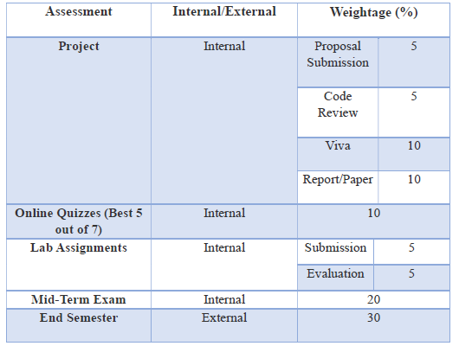
Evaluation Policy

Slide 4
Introduction to Machine Learning
What is Machine Learning?
Why Machine Learning?
Formal Definition : T,E,P for Machine Learning

Slide 5
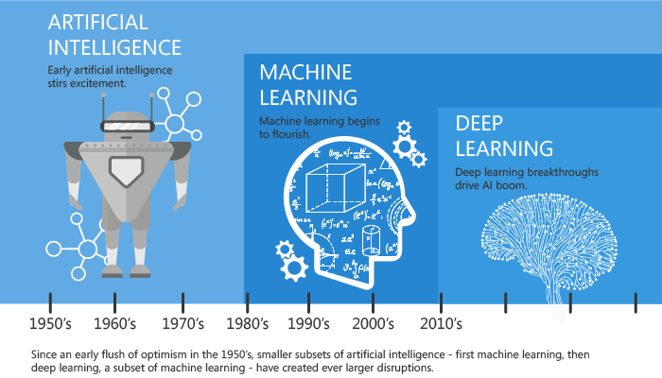
Machine Learning: A subset of Artificial Intelligence
Source : https://towardsdatascience.com/introduction-to-machine-learning-for-beginners-eed6024fdb08

Slide 6


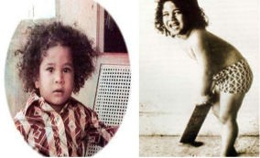
Why Machine Learning ? : A motivational example
Look at the images and understand/remember the patterns.
Model and generalization
Machine learning algorithms generate model.
Model is a mathematical structure that learns and generalize the data
Not coded...(If curly hair then sachin)

Slide 7



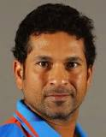

Why generate model ?
Guess : Is this Sachin ??
Model 1
Model 2
From binary world to Probability world
Likelihood of an image to be of Sachin.
REDUCE GENERALIZATION ERROR !!!

Slide 8

Machine Learning Definition
Definition 1 : Arthur Samuel(1959)
Field of study that gives computers the ability to learn without being explicitly programmed.
Definition 2 : Tom Mitchell (1998)
A computer program is said to learn from Experience E with respect to some Task T and some Performance measure P, if its performance on T, as was measured by P, improves with experience E.

Slide 9
Task ,Experience, Performance
Ill posed problem :
Recognize Sachin Tendulkar in the given Photographs
Well posed Problem
Task: Check if the face in an image is of Sachin or not
Experience: Various Images of Sachin
Performance: Out of 100 photographs, how many times was Sachin identified with more than 90% confidence

Slide 10
Takeaways
Definition of Machine Learning
Ill Posed Problem to Well posed problem
3 important parameters : Task, Experience, Performance

Slide 11
References
https://towardsdatascience.com/introduction-to-machine-learning-for-beginners-eed6024fdb08
https://www.houseofbots.com/news-detail/11973-1-clarifying-differences-between-data-analysis-data-mining-data-science-machine-learning,-and-big-data

